Slide 1



SSARS: Smart Society Alert & Resource System
NAME : RAJODIYA RAJKUMAR KETANBHAI
ENROLL NO : 230021780210108
BRANCH : IT
BATCH : C4

Slide 2
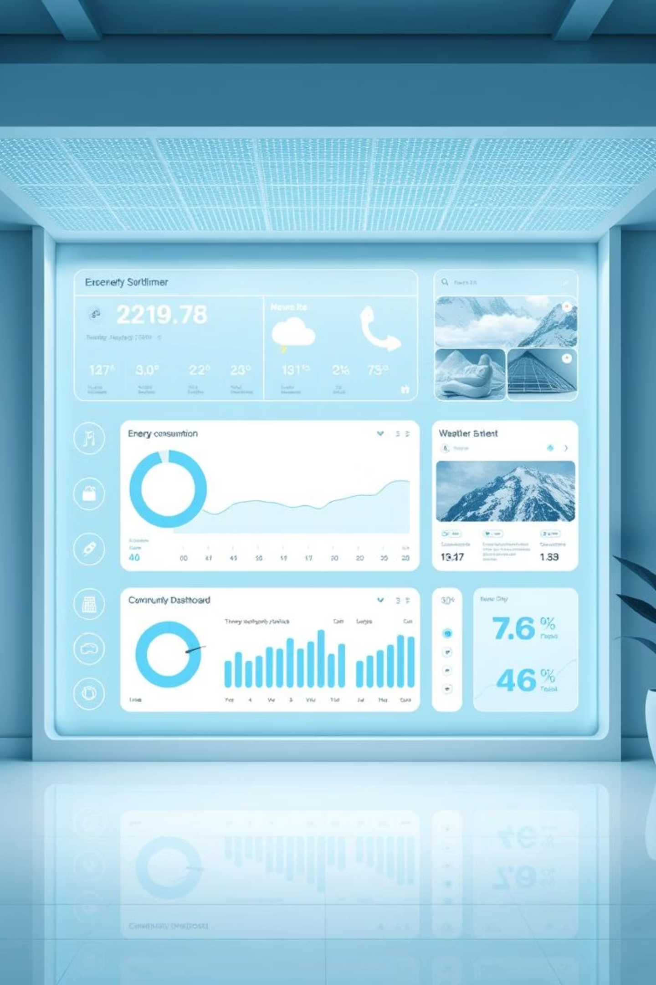
Project Overview
SSARS is a Django-based intelligent web application designed for smart societies and residential communities. It integrates real-time energy monitoring, weather intelligence, and news aggregation with machine learning-powered optimization to enhance efficiency and sustainability.

Slide 3





Key Features at a Glance
Energy Analysis
Weather Intelligence
News Hub
Real-time monitoring, ML predictions, and cost insights for optimized consumption.
Live weather data, 5-day forecasts, and crucial alerts for informed decisions.
Centralized news updates with visual context, keeping communities informed.
User Management
AI Optimization
Secure sign-in processes and personalized profile handling for each resident.
Smart alerts and efficiency recommendations for proactive resource management.

Slide 4
Under the Hood: Technology Stack
Backend & Frontend
Backend: Django, SQLite3/PostgreSQL
Frontend: Bootstrap 5, Vanilla JS
Machine Learning
Models: Random Forest, Linear Regression (scikit-learn)
Purpose: Predictive analytics for energy consumption and resource optimization, enabling proactive insights.
Data & APIs
APIs: OpenWeatherMap, Geocoding API
Data Tools: Pandas, NumPy, Matplotlib, Seaborn

Slide 5




How SSARS Works: A Seamless Flow
Data Collection
ML Processing
Gathers real-time energy usage and weather data from various sources.
Utilizes Random Forest and Linear Regression models to analyze and predict patterns.
Insight Generation
Dashboard Display
Creates actionable alerts, accurate forecasts, and detailed cost analyses.
Presents insights on interactive, user-friendly dashboards for easy access.
This streamlined process ensures that communities receive timely, accurate, and actionable information to optimize their resource consumption effectively.

Slide 6

Robust Project Structure
ssars/: The main Django application, housing core functionality.
static/: Stores essential static files like images, CSS, and JavaScript.
templates/: Contains all HTML pages for rendering the web interface.
energy/, weather/, news/: Dedicated modules for specific features, ensuring modularity.
ML models: Pre-trained machine learning models stored via Joblib for efficient predictions.
This organized structure ensures scalability, maintainability, and efficient development.

Slide 7
Advancing Intelligence: Future Scope
IoT Smart Meter Integration
Dedicated Mobile Application
Automated Energy-Saving Actions
Direct connection with IoT smart meters for hyper-accurate, real-time energy data collection and analysis.
Development of a native mobile app for iOS and Android, providing instant alerts and on-the-go management.
Implementing AI-driven automation to directly control smart devices for optimal energy conservation.
These future enhancements aim to transform SSARS into an even more proactive and integrated solution for smart communities.

Slide 8

Transforming Urban Living with SSARS
SSARS represents a significant step towards creating more sustainable, efficient, and informed residential communities. By leveraging intelligent data analysis and AI, we empower users to make smarter decisions about their energy and resource consumption.

Slide 9
Key Takeaways
Holistic Approach: SSARS unifies energy, weather, and news for a comprehensive community management system.
AI-Driven Efficiency: Machine learning models provide predictive insights and optimization recommendations.
Scalable & User-Friendly: Built with Django, Bootstrap, and modern tools for robust performance and intuitive design.
Future-Ready: Prepared for IoT integration and mobile expansion to meet evolving smart society needs.
SSARS is poised to become an indispensable tool for intelligent urban resource management.

Slide 10
Thank You!
Connect with us for more details and collaboration opportunities.

